Slide 1
Natural Language Processing for Healthcare
A Case Study of MIMIC III Dataset
Neal Cheng, Joshua Sherfey, Oren Tevet, Kevin Zhu
28 April 2019
Notes:
Today we will cover the topic of Natural language Processing for Healthcare.
This will be a case study on the MIMIC III Dataset
This Project was designed and completed by Neal Chang, Joshua Sherfey, Oren Tevet, and Kevin Zhu

Slide 2
Outline
Introduce Problem
MIMIC III Dataset
Preprocessing
Current NLP Techniques
Universal Language Model Fine-Tuning
Experimental Results
Future Research
Notes:
In this presentation, we will first introduce the problem
Then we will review the dataset used
Next we will cover our preprocessing steps
Later we will review current natural language processing techniques
And also introduce the model in focus, Universal Language Model Fine-Tuning
Finally, we will review our experimental results and discuss future research

Slide 3
Internationational Classification Diseases Labeling
In 1967, International Classification of Diseases (ICD) system to “monitor the incidence and prevalence of diseases, observe reimbursements and resource allocation trends, and keep track of safety and quality guidelines.”¹
ICD labeling is done manually by administrative personnel based on definitions.²
ICD labeling is subject to interpretation differences and errors.
The goal of this project is to transform physicians’ clinical notes in the form of unstructured text data to ICD-9 codes as a systematic and accurate way to classify and report diseases.
Notes:
The problem we will cover is the labeling of International Classification Diseases, or ICD’s
The ICD systems was created in 1967 in order to monitor the incidence and prevalence of diseases, observe reimbursement and resource allocation trends, and keep track of safety and quality guidelines
Traditionally, ICD labeling has been completed manually by administrative personel, causing ICD labeling to be prone to errors and subject to interpretation
The goal of this project is to transform physicians’ clinical notes in the form of unstructured text data to ICD-9 codes as a systematic and accurate way to classify and report diseases.

Slide 4
MIMIC III
Database of ICU patients at Beth Israel Deaconess Medical Center.
41,000 patients between 2001 and 2012
53,000 hospital admissions
Noteevents table contains discharge notes and ICD-9 label codes
2,083,180 instances
8,921 unique ICD-9 codes
76.9% of hospital admissions have a top 10 most common ICD-9 code³
ICD-9 Code | Patient Count | Hospital Admissions
4019: Hypertension | 17,138 | 20,046
4280: Congestive Heart Failure | 9,669 | 12,842
41401: Atrial Fibrillation | 10,053 | 12,589
Top 3 most common ICD-9 codes by hospital admissions count.
Notes:
Moving onto our dataset
MIMIC-III is an open-access relational database containing tables of data relating to patients who stayed within the ICU at Beth Israel Deaconess Medical Center.
The database includes 41,000 patients and 53,000 hospital admissions between 2001 and 2012
For this project we focus our efforts on the discharge notes and ICD label codes
These discharge notes and ICD-9 label codes were found in the noteevents table.
In the data, we found there to be around 2 million instances and 9 thousand unique ICD-9 codes
Additionally, over 3 quareters of hospital admissions had an ICD-9 code within the top 10 most common codes

Slide 5
Preprocessing
Utilized distributed cluster-computing framework, Spark, to efficiently preprocess dataset
Dataset was processed to filter for the top 10 and top 50 most common ICD-9 codes.
Split data into 80%/20% training/testing distribution.
Notes:
To accomplish our preprocessing, we utilized a distributed cluster-computing framework, PySpark, to efficiently preprocess our dataset
Since most hospital admissions fell within the top 50 most frequent ICD-9 codes, The Dataset was processed to filter for the top 10 and top 50 most common ICD-9 codes
For testing purposes, we split training testing data with an 80 20 distribution

Slide 6
Current Natural Language Processing Techniques
Linear Regression
Logistic Regression
Random Forests
Neural Networks Architectures
Convolution Neural Network (CNN)
Recurrent Neural Network (RNN)
Long Short-term Memory (LSTM)
Notes:
Current Natural Language Processing Techniques that have been applied to this ICD labeling problems include
Linear Regression
Logistic Regression
Random Forests
And Neural Network Architecture, s
Such as
Convolution Neural Network
Recurrent Neural Network
and
Long Short-term Memory
RNN:
designed to capture past dependencies through its internal states.
suffers from numerous deficiencies:
such the vanishing or exploding gradient
the inability to capture long-term dependencies
LSTM:
Addresses RNN inability to capture long-term dependencies
Has numerous forget gates to store temporal information
GRNN:
employs a modified GRU with dimensions dedicated to predicting the presence of individual labels
RNN and LSTM models have the highest accuracy compared to Binary Logistic Regression models.

Slide 7
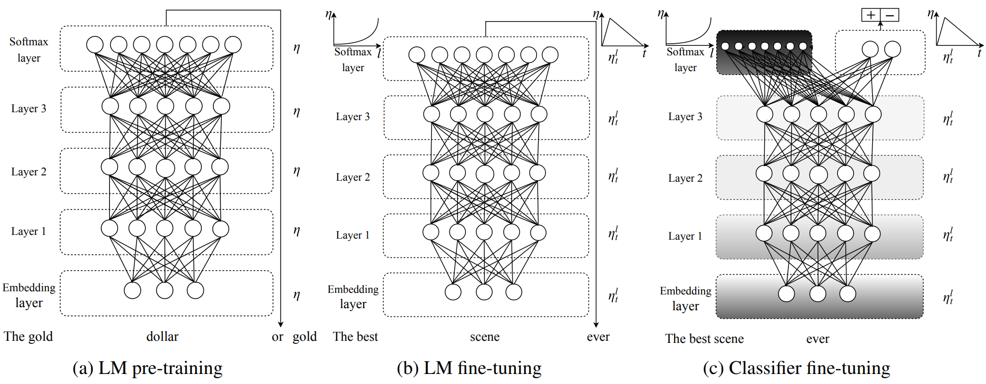
Universal Language Model Fine-Tuning (ULMFit)
Introduced by Howard and Ruder in 2018⁴
Figure from Howard and Ruder⁴
Notes:
Our project’s focus was to apply the Universal Language Model Fine Tuning, or ULMFit, to the ICD labeling problem.
ULMFit was first introduced in 2018 by Howard and Ruder
In this visualization we can see the three major steps of ULMFit:
First, The Language model is pretrained on a larger corpus. For our project, we used a model that was already pretrained
Second, the model is fined tuned to adapt to our corpus of interest, the MIMIC III diagnostic notes
Lastly, the Classifier is fine tuned to ICD-9 code using supervised learning techniques. Our model was augmented with two additional linear layers to adapt the model to our classification problem.

Slide 8
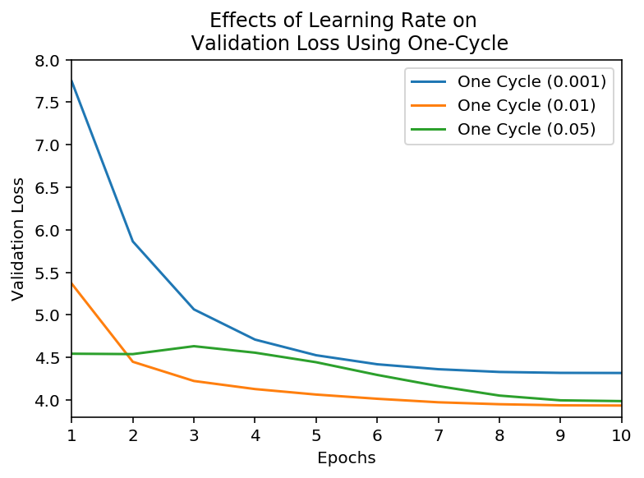
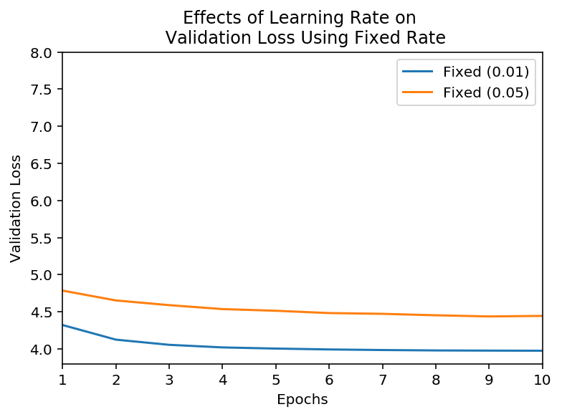
Training the Language Model
There is an optimal learning rate for the one-cycle policy of 0.01, which ensures quicker convergence and lower validation loss. However, we observe quicker convergence and comparable performance with a fixed rate, demonstrating the lack of effectiveness of the one-cycle policy for our problem
Notes:
Once our preprocessing was complete, the pretrained language model was further trained on the preprocessed discharge notes data.
We analyzed the language model performance of multiple training rates and found a learning rate of 0.01 to have the quickest convergence and lowest validation loss
We found similar performance for both one cycle and fixed rate
We then took the encoder portion of the best performing language model and moved on to the nextstep, training the classifier model

Slide 9
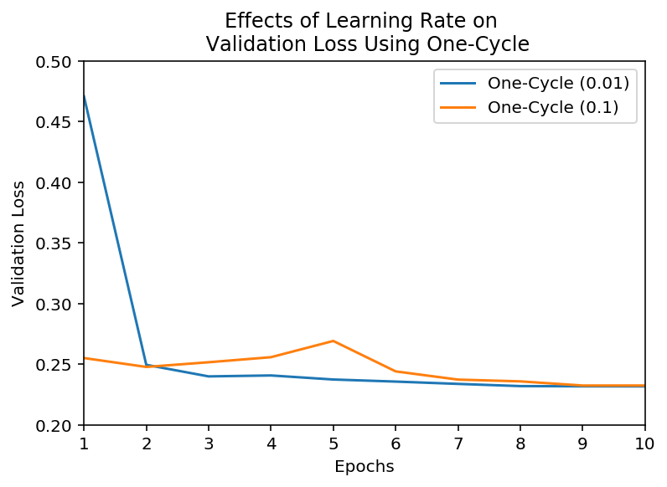
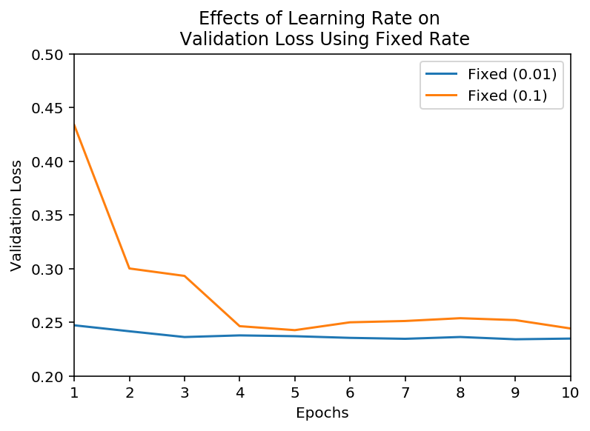
Training the Classifier Model
Once again, comparable validation performance for both one-cycle and fixed-rate for a learning rate of 0.01 was observed. We have found no evidence of so-called “superconvergence” within the MIMIC dataset within ten epochs.
Notes:
Once again, we observed a learning rate of of 0.01 for both one-cycle and fixed-rate.
In our analysis, We found no evidence of “superconvergence” in the MIMIC III dataset within ten epochs.

Slide 10
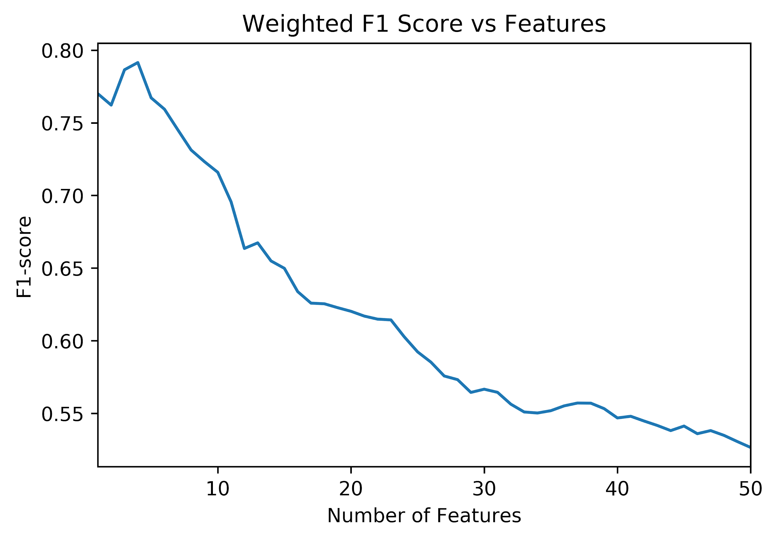
ULMFit Model Performance
Top 10 Weighted F1 Score: 0.716
Top 50 Weighted F1 Score: 0.526
ROC AUC 0.883
Notes:
Looking at the performance of the ULMFit model,
We saw the top 10 weighted F1 score was 0.716
Whereas the top 50 weighted F1 score was 0.526
We also found the ROC Area under curve to be 0.883
The figure on the right shows weighted F1 score over the number of features included.

Slide 11
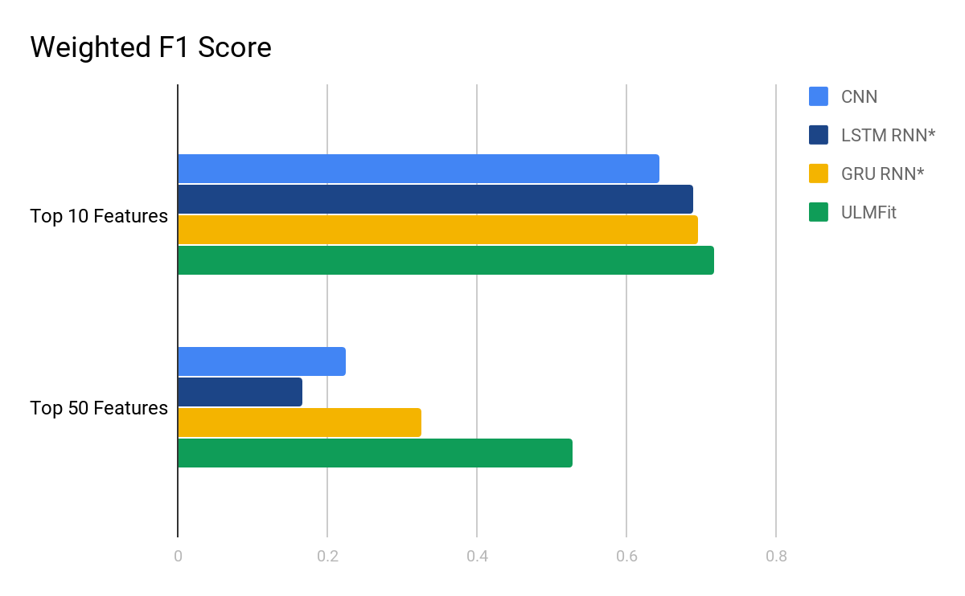
Model Comparison
Comparing performance of ULMFit with previous RNN models.
* Results found in previous study³.
Notes:
We then compared performance of ULMFit with previous model performances.
The results indicate that ULMFit performed slightly better than LSTM and GRU for top 10 features
When analyzing the top 50 features, however, ULMFit outperformed the other models by a large margin, with a weighted F1 score over 60% higher than next best performing model

Slide 12
Future Research
We plan to research the effects of different training techniques such as cosine annealing and stochastic gradient descent with restarts (SGDR)
Transformer models such as BERT-base or BERT-large should yield better results using an attention-based approach
Notes:
In the future, We plan to research the effects of different training techniques such as cosine annealing and stochastic gradient descent with restarts (SGDR)
Moreover, Transformer models such as BERT-base or BERT-large should yield better results using an attention-based approach

Slide 13
References
World Health Organization. International classification of diseases (ICD). http://www. who. int/classifications/icd/en/. 2006.
Woolhandler S, Himmelstein DU. Administrative work consumes one-sixth of US physicians' working hours and lowers their career satisfaction. International Journal of Health Services. 2014 Oct;44(4):635-42.
Huang J, Osorio C, Sy LW. An empirical evaluation of deep learning for ICD-9 code assignment using MIMIC-III clinical notes. arXiv preprint arXiv:1802.02311. 2018 Feb 7.
Howard J, Ruder S. Universal language model fine-tuning for text classification. arXiv preprint arXiv:1801.06146. 2018 Jan 18.

